Slide 1
Ethics in Information Technology, Fourth Edition
Chapter 7
Software Development
Notes:
‹#›

Slide 2
Objectives
As you read this chapter, consider the following questions:
Why do companies require high-quality software in business systems, industrial process control systems, and consumer products?
What potential ethical issues do software manufacturers face in making trade-offs between project schedules, project costs, and software quality?
What are the four most common types of software product liability claims?
Ethics in Information Technology, Fourth Edition
‹#›
Notes:
‹#›

Slide 3
Objectives (cont’d.)
What are the essential components of a software development methodology, and what are the benefits of using such a methodology?
How can the Capability Maturity Model Integration improve an organization’s software development process?
What is a safety-critical system, and what special actions are required during its development?
Ethics in Information Technology, Fourth Edition
‹#›
Notes:
‹#›

Slide 4
Strategies for Engineering Quality Software
High-quality software systems:
Perform quickly and efficiently
Operate safely and reliably
Meet their users’ needs
Are required to support the fields of:
Air traffic control
Nuclear power
Automobile safety
Health care
Military and defense
Space exploration
Ethics in Information Technology, Fourth Edition
‹#›
Notes:
‹#›

Slide 5
Strategies for Engineering Quality Software (cont’d.)
Increased demand for high-quality software
End users cannot afford system crashes, lost work, or lower productivity, nor can they tolerate security holes through which intruders can spread viruses, steal data, or shut down Web sites
Software defect
Could cause a system to fail to meet users’ needs
Impact may be trivial or very serious
Subtle and undetectable or glaringly obvious
Software quality
Degree to which software meets the needs of users
Ethics in Information Technology, Fourth Edition
‹#›
Notes:
‹#›

Slide 6
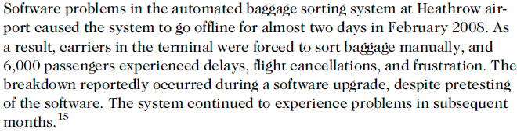
Strategies for Engineering Quality Software (cont’d.)
Ethics in Information Technology, Fourth Edition
‹#›
Notes:
‹#›

Slide 7
Strategies for Engineering Quality Software (cont’d.)
Quality management
Defines, measures, and refines the quality of the development process and products developed during various stages
Objective
Help developers deliver high-quality systems that meet the needs of users
Deliverables are products such as:
Statements of requirements
Flowcharts
User documentation
Ethics in Information Technology, Fourth Edition
‹#›
Notes:
‹#›

Slide 8
Strategies for Engineering Quality Software (cont’d.)
Primary cause for poor software quality:
Many developers do not know how to design quality into software from the start
Or do not take the time to do so
Developers must:
Define and follow rigorous engineering principles
Learn from past mistakes
Understand systems’ operating environment
Design systems relatively immune to human error
Ethics in Information Technology, Fourth Edition
‹#›
Notes:
‹#›

Slide 9
Strategies for Engineering Quality Software (cont’d.)
Programmers make mistakes in turning design specifications into code
About one defect for every 7-10 lines of code
Extreme pressure to reduce time to market
Driven by need to:
Deliver new functionality
Begin generating revenue to recover costs
Resources and time to ensure quality are often cut
Ethics in Information Technology, Fourth Edition
‹#›
Notes:
‹#›

Slide 10
Strategies for Engineering Quality Software (cont’d.)
Ethical dilemma: how much additional cost and effort should be expended to ensure products and services meet customers’ expectations?
First release of software
Organizations avoid buying the first release
Or prohibit its use in critical systems
Usually has many defects
Established software products can also falter:
When operating conditions change
Ethics in Information Technology, Fourth Edition
‹#›

Slide 11
Strategies for Engineering Quality Software (cont’d.)
Established software products can also falter:
When operating conditions change the software - in the Cincinnati Bell telephone switch had been thoroughly tested and had operated successfully for months after it was deployed. Later that year, however, when the time changed from daylight saving time to standard time, the switch failed because it was overwhelmed by the number of calls to the local “official time” phone number from people who wanted to set their clocks. The large increase in the number of simultaneous calls to the same number was a change in operating conditions that no one had anticipated.
Ethics in Information Technology, Fourth Edition
‹#›

Slide 12
The Importance of Software Quality
Business information systems
Set of interrelated components including:
Hardware
Software
Databases
Networks
People
Procedures
Collect and process data and disseminate the output
Ethics in Information Technology, Fourth Edition
‹#›
Notes:
‹#›

Slide 13
The Importance of Software Quality (cont’d.)
Business information system examples
Manufacturer’s order-processing system
Bank’s electronic-funds transfer system
Airline’s online ticket reservation system
Decision support system (DSS)
Used to improve decision making
Software is used to control industrial processes
Software controls the operation of many industrial and consumer products
Ethics in Information Technology, Fourth Edition
‹#›
Notes:
‹#›

Slide 14
The Importance of Software Quality (cont’d.)
Mismanaged software can be fatal to a business
Ethical questions
How much effort and money to invest to ensure high-quality software
Whether products could cause damage and what the legal exposure would be if they did
The use of software introduces product liability issues – concerns for executives
Ethics in Information Technology, Fourth Edition
‹#›
Notes:
‹#›

Slide 15
Software Product Liability
Product liability
Liability of manufacturers, sellers and others for injuries caused by defective products
Ford truck stalled because of a software defect in the truck’s fuel injector. In the ensuing accident, a young child was killed.1 A state supreme court later affirmed an award of $7.5 million in punitive damages against the manufacturer.
In October 2008, a faulty onboard computer caused a Qantas passenger flight en route to Perth from Singapore to plunge some 8,000 feet in 10 seconds, injuring 46 passengers.
Ethics in Information Technology, Fourth Edition
‹#›
Notes:
‹#›

Slide 16
Software Product Liability
Product liability
There is no federal product liability law
Mainly common law - state level
Software defect can cause lawsuit if
Injury-death
Loss of revenue
Increase in cost
Ethics in Information Technology, Fourth Edition
‹#›
Notes:
‹#›

Slide 17
Software Product Liability
Software liability claims are based on
Strict liability
Negligence
Breach of warranty
Misrepresentation
Strict liability
Defendant held responsible for the injury
Regardless of negligence or intent
Ethics in Information Technology, Fourth Edition
‹#›
Notes:
‹#›

Slide 18
Software Product Liability (cont’d.)
Strict liability
Plaintiff must prove only that the software product is defective or unreasonably dangerous and that the defect caused the injury
No requirement to prove that the manufacturer was careless or negligent or to prove who caused the defect
All parties in the chain of distribution are liable
Manufacturer
Subcontractors
Distributors
Ethics in Information Technology, Fourth Edition
‹#›
Notes:
‹#›

Slide 19
Software Product Liability (cont’d.)
Strict liability
Defendants defense
Doctrine of supervening event ?
Government contractor defense ?
Expired statute of limitations
Ethics in Information Technology, Fourth Edition
‹#›
Notes:
‹#›

Slide 20
Software Product Liability (cont’d.)
Negligence
Failure to do what a reasonable person would do, or doing something that a reasonable person would not do
Responsibility is limited to defects that could have been detected and corrected through “reasonable” software development practices
Ethics in Information Technology, Fourth Edition
‹#›
Notes:
‹#›

Slide 21
Software Product Liability (cont’d.)
Negligence
Area of great risk for software manufacturers
Defense of negligence may include:
Legal justification for the alleged misconduct
Demonstration that the plaintiffs’ own actions contributed to injuries (contributory negligence)
Ethics in Information Technology, Fourth Edition
‹#›
Notes:
‹#›

Slide 22
Software Product Liability (cont’d.)
Warranty
Assures buyers or lessees that a product meets certain standards of quality
May be expressly stated or implied by law
Breach of warranty claim
When the product fails to meet the terms of its warranty
Plaintiff must have a valid contract that the supplier did not fulfill
Can be extremely difficult to prove because the software supplier writes the warranty to limit liability
Ethics in Information Technology, Fourth Edition
‹#›
Notes:
‹#›

Slide 23
Software Product Liability (cont’d.)
Intentional misrepresentation
Seller or lessor either misrepresents the quality of a product or conceals a defect in it
Forms of representation
Advertising
Salespersons’ comments
Invoices
Shipping labels
Most software manufacturers use limited warranties and disclaimers to avoid any claim of misrepresentation.
Ethics in Information Technology, Fourth Edition
‹#›
Notes:
‹#›

Slide 24
Software Development Process
Large software project roles
System analysts
Programmers
Architects
Database specialists
Project managers
Documentation specialists
Trainers
Testers
Ethics in Information Technology, Fourth Edition
‹#›
Notes:
‹#›

Slide 25
Software Development Process (cont’d.)
Software development methodology
Standard, proven work process
Controlled and orderly progress
Defines activities in software development process
Defines individual and group responsibilities
Recommends specific techniques for activities
Offers guidelines for managing the quality of software during various stages of development
Ethics in Information Technology, Fourth Edition
‹#›
Notes:
‹#›

Slide 26
Software Development Process (cont’d.)
Easier and cheaper to avoid software problems at the beginning than to attempt to fix damages after the fact
Cost to identify and remove a defect in an early stage can be up to 100 times less than removing a defect in distributed software
Identify and remove errors early in the development process
Cost-saving measure
Most efficient way to improve software quality
Ethics in Information Technology, Fourth Edition
‹#›
Notes:
‹#›

Slide 27
Software Development Process (cont’d.)
Effective methodology protects from legal liability
Reduces the number of software errors
If an organization follows widely accepted development methods, negligence on its part is harder to prove
Software quality assurance (QA) refers to methods within the development cycle
Guarantee reliable operation of product
Are applied at each stage in the development cycle
Include testing before the product ships
Ethics in Information Technology, Fourth Edition
‹#›
Notes:
‹#›

Slide 28
Software Development Process (cont’d.)
Dynamic testing
Black-box testing
Tester has no knowledge of code
White-box testing
Testing all possible logic paths in the software unit, with thorough knowledge of the logic
Makes each program statement execute at least once
Ethics in Information Technology, Fourth Edition
‹#›
Notes:
‹#›

Slide 29
Software Development Process (cont’d.)
Static testing
Static analyzers are run against the new code
Looks for suspicious patterns in programs that might indicate a defect
Integration testing
Occurs after successful unit testing
Software units are combined into an integrated subsystem
Ensures that all linkages among various subsystems work successfully
Ethics in Information Technology, Fourth Edition
‹#›
Notes:
‹#›

Slide 30
Software Development Process (cont’d.)
System testing
Occurs after successful integration testing
Various subsystems are combined
Tests the entire system as a complete entity
User acceptance testing
Independent testing performed by trained end users
Ensures that the system operates as they expect
Ethics in Information Technology, Fourth Edition
‹#›
Notes:
‹#›

Slide 31
Capability Maturity Model Integration
Process improvement approach
Defined by the Software Engineering Institute
At Carnegie Mellon University in Pittsburgh
Defines essential elements of effective processes
General enough to evaluate and improve almost any process
Frequently used to assess software development practices
Ethics in Information Technology, Fourth Edition
‹#›
Notes:
‹#›

Slide 32
Capability Maturity Model Integration (cont’d.)
Defines five levels of software development maturity
Identifies issues most critical to software quality and process improvement
Organization conducts an assessment of its software development practices
Determines where they fit in the capability model
Identifies areas for improvement
Action plans defined to upgrade the development process
Ethics in Information Technology, Fourth Edition
‹#›
Notes:
‹#›

Slide 33
Capability Maturity Model Integration (cont’d.)
Maturity level increases
Organization improves its ability to deliver good software on time and on budget
CMMI-Development
Set of guidelines for 22 process areas related to systems development
Organizations that do these 22 things well will have an outstanding software development and maintenance process
Ethics in Information Technology, Fourth Edition
‹#›
Notes:
‹#›

Slide 34
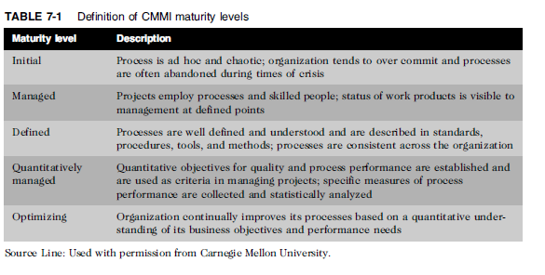
Capability Maturity Model Integration (cont’d.)
Ethics in Information Technology, Fourth Edition
‹#›
Notes:
‹#›

Slide 35
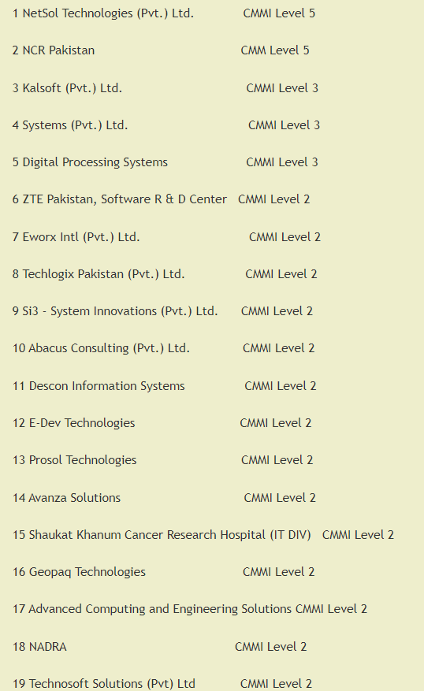

Slide 36
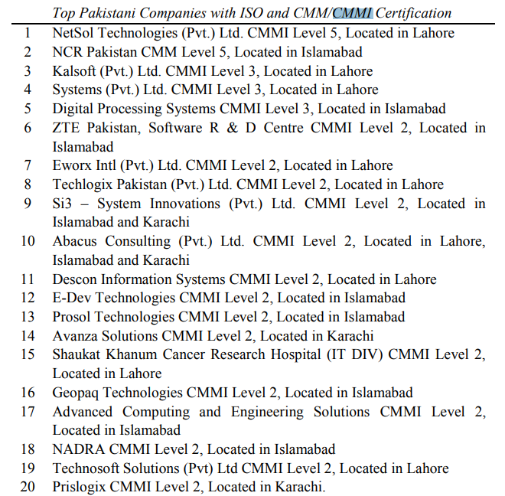

Slide 37
Key Issues in Software Development
Consequences of software defects in certain systems can be deadly
Companies must take special precautions
Ethical decisions involve a trade-off between quality and cost, ease of use, and time to market
Ethics in Information Technology, Fourth Edition
‹#›
Notes:
‹#›

Slide 38
Development of Safety-Critical Systems
Safety-critical system
A system whose failure may cause injury or death
Examples
Nuclear power plant reactors
Airplane navigation
Roller coasters
Elevators
Medical devices
Ethics in Information Technology, Fourth Edition
‹#›
Notes:
‹#›

Slide 39
Development of Safety-Critical Systems (cont’d.)
Key assumption
Safety will not automatically result from following the organization’s standard development methodology
Requires a more rigorous and time-consuming development process than other kinds of software
All tasks require:
Additional steps
More thorough documentation
Vigilant checking and rechecking
Ethics in Information Technology, Fourth Edition
‹#›
Notes:
‹#›

Slide 40
Development of Safety-Critical Systems (cont’d.)
Project safety engineer
Explicit responsibility for the system’s safety
Uses a logging and monitoring system:
To track hazards from the project’s start to finish
Hazard log
Used at each stage of the software development process to assess how project team has accounted for detected hazards
Ethics in Information Technology, Fourth Edition
‹#›
Notes:
‹#›

Slide 41
Development of Safety-Critical Systems (cont’d.)
Safety reviews
Held throughout the development process
Robust configuration management system
Tracks all safety-related documentation
Formal documentation required
Including verification reviews and signatures
Key issues
Ethical dilemmas re: increased time and expense
Deciding when QA staff has performed enough testing
Ethics in Information Technology, Fourth Edition
‹#›
Notes:
‹#›

Slide 42
Development of Safety-Critical Systems (cont’d.)
Risk
Probability of an undesirable event occurring times the magnitude of the event’s consequences
Consequences include:
Damage to property
Loss of money
Injury to people
Death
Ethics in Information Technology, Fourth Edition
‹#›
Notes:
‹#›

Slide 43
Development of Safety-Critical Systems (cont’d.)
Redundancy
Provision of multiple interchangeable components to perform a single function
Used to cope with failures and errors
During times of widespread disaster, lack of sufficient redundant can lead to major problems
Hurricane Katrina knocked out 2.5 million telephone lines, four TV stations, and 36 radio stations, there were inadequate backup communication systems to replace those failed systems.
Ethics in Information Technology, Fourth Edition
‹#›
Notes:
‹#›

Slide 44
Development of Safety-Critical Systems (cont’d.)
N-version programming
Form of redundancy
Involves the execution of a series of program instructions simultaneously by two different systems
Uses different algorithms to execute instructions that accomplish the same result
IBM employs N-version programming to reduce disk sector failures
Ethics in Information Technology, Fourth Edition
‹#›

Slide 45
Development of Safety-Critical Systems (cont’d.)
N-version programming (cont’d.)
Results from the two systems are compared
If a difference is found, another algorithm is executed to determine which system yielded the correct result
Instructions for the two systems can be:
Written by programmers from two different companies
Run on different hardware devices
Rationale
Both systems are highly unlikely to fail at the same time under the same conditions
Ethics in Information Technology, Fourth Edition
‹#›
Notes:
‹#›

Slide 46
Development of Safety-Critical Systems (cont’d.)
Decide what level of risk is acceptable
Difficult and controversial decision
Make system modifications if level of risk is judged to be too great
Mitigate the consequences of failure
Devise emergency procedures and evacuation plans
Decide whether to recall a product:
When data indicates a problem
Ethics in Information Technology, Fourth Edition
‹#›
Notes:
‹#›

Slide 47
Development of Safety-Critical Systems (cont’d.)
Reliability
Probability of a component or system performing without failure over its product life
Human interface
Important and difficult area of safety-critical system design
Should leave the operator little room for erroneous judgment
Poor design of a system interface can greatly increase risk
Ethics in Information Technology, Fourth Edition
‹#›
Notes:
‹#›

Slide 48
Development of Safety-Critical Systems (cont’d.)
in July 1988, the guided missile cruiser USS Vincennes mistook an Iranian Air commercial flight for an enemy F-14 jet fighter and shot the airliner down over international waters in the Persian Gulf—killing almost 300 people. Some investigators blamed the tragedy on the confusing interface of the $500 million Aegis radar and weapons control system. The Aegis radar on the Vincennes locked onto an Airbus 300, but it was misidentified as a much smaller F-14 by its human operators. The Aegis operators also misinterpreted the system signals and thought that the target was descending, even though the airbus was actually climbing. A third human error was made in determining the target altitude— it was off by 4,000 feet. As a result of this combination of human errors, the Vincennes crew thought the ship was under attack and shot down the plane.
Ethics in Information Technology, Fourth Edition
‹#›
Notes:
‹#›

Slide 49
Quality Management Standards
ISO 9001 family of standards
Guide to quality products, services, and management
Organization must submit to an examination by an external assessor
Requirements
Written procedures for everything it does
Follow those procedures
Prove to the auditor the organization fulfilled the first two requirements
Ethics in Information Technology, Fourth Edition
‹#›
Notes:
‹#›

Slide 50
Quality Management Standards (cont’d.)
Failure mode and effects analysis (FMEA)
Technique used to evaluate reliability and determine the effect of system and equipment failures
Failures are classified by:
Impact on a project’s success
Personnel safety
Equipment safety
Customer satisfaction and safety
Goal
Identify potential design and process failures early in a project
Ethics in Information Technology, Fourth Edition
‹#›
Notes:
‹#›

Slide 51
Quality Management Standards (cont’d.)
Failure mode and effects analysis (FMEA)
LifeScan is part of Johnson & Johnson, and for over 20 years it has developed products for people with diabetes. Every day, more than 3 million people depend on its OneTouch Systems to capture accurate test results of their blood glucose levels.30 LifeScan uses FMEA methods to test the software for the automated test and assembly stations on the blood glucose meter manufacturing lines.
Ethics in Information Technology, Fourth Edition
‹#›
Notes:
‹#›

Slide 52
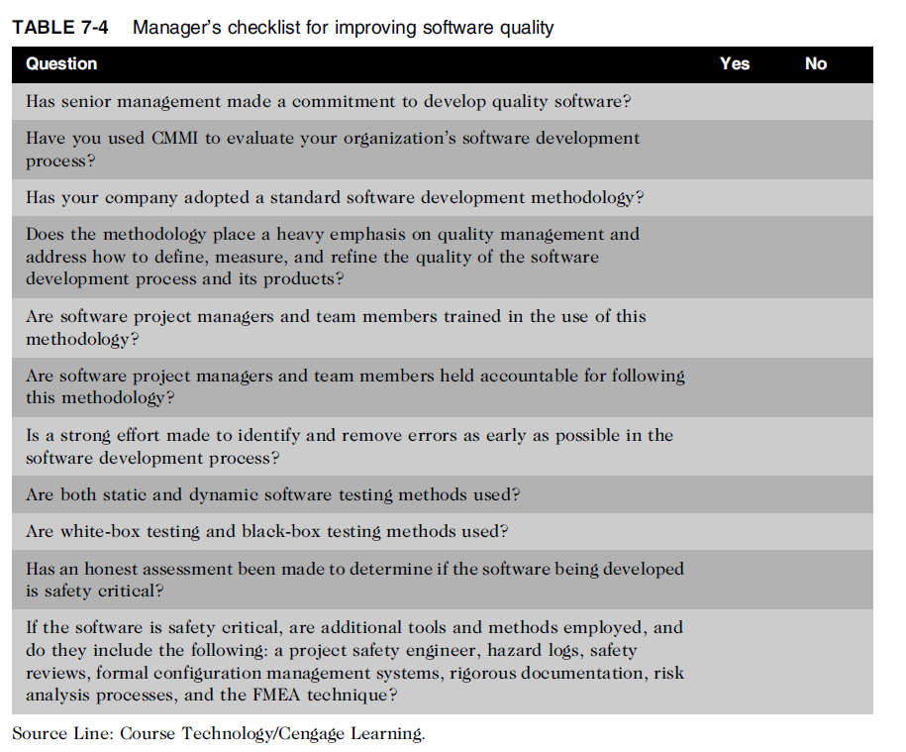
Ethics in Information Technology, Fourth Edition
‹#›
Notes:
‹#›

Slide 53
Summary
Demand for high-quality software is increasing
Developers are under extreme pressure to reduce time to market of products
Software product liability claims are frequently based on:
Strict liability
Negligence
Breach of warranty
Misrepresentation
Ethics in Information Technology, Fourth Edition
‹#›
Notes:
‹#›

Slide 54
Summary (cont’d.)
Software development methodology
Defines activities in the development process
Defines individual and group responsibilities
Recommends specific techniques
Offers guidelines for managing product quality
CMMI
Defines five levels of software development maturity
Safety-critical system
Failure may cause injury or death
Ethics in Information Technology, Fourth Edition
‹#›
Notes:
‹#›

Slide 55
Summary (cont’d.)
ISO 9001 standard is a guide to quality products, services, and management
Failure mode and effects analysis (FMEA) is an important technique used to develop ISO 9001-compliant quality systems
Ethics in Information Technology, Fourth Edition
‹#›
Notes:
‹#›

